Slide 1
AtliQ Hospitality
Analysis
Introduction
Details of Data
Dashboard / Design
Findings
Recommendations
Reference Link of Dashboard :
https://github.com/21AnkurSingh2000/AtliQ-Hospitality/blob/main/AtliQ%20Hospitality.pbix
(Raw Download this file and open via Power Bi)

Slide 2
Introduction to Atliq Hospitality Data Analysis
Atliq Hospitality is a prominent player in the hospitality industry, offering a range of accommodations that cater to diverse customer needs. With a commitment to enhancing guest experiences, Atliq Hospitality leverages data analysis to drive decision-making, optimize operations, and improve overall performance.
This data analysis aims to provide valuable insights into the company’s performance across various dimensions, including revenue generation, occupancy rates, customer satisfaction, and booking trends. By analyzing key metrics, such as revenue by city, room class, and booking platform, the analysis seeks to identify strengths, weaknesses, and opportunities for growth.
As the hospitality sector becomes increasingly competitive, data-driven strategies are essential for enhancing customer experiences, optimizing pricing, and maximizing occupancy rates. This analysis will not only highlight current performance but also propose actionable recommendations for improving guest satisfaction, increasing revenue, and reducing cancellation rates.
Through a comprehensive examination of data, Atliq Hospitality aims to strengthen its market position and continue its commitment to excellence in service delivery.

Slide 3
Details of Data
1. dim_date: Contains date-related information.
  date: Specific dates (May, June, July).
  mmm yy: Formatted month and year.
  week no: Unique week number.
  day_type: Indicates Weekend or Weekday.
2. dim_hotels: Holds hotel information.
  property_id: Unique hotel ID.
  property_name: Name of the hotel.
  category: Hotel classification (Luxury, Business).
  city: Location of the hotel.
3. dim_rooms: Describes room types.
  room_id: Type of room (e.g., RT1, RT2).
  room_class: Class of the room (Standard, Elite, etc.).
4. fact_aggregated_bookings: Aggregates booking data.
  property_id: Hotel ID.
  check_in_date: Customer check-in dates.
  room_category: Type of room booked.
  successful_bookings: Count of successful bookings.
  capacity: Maximum room availability.
5. fact_bookings: Captures individual booking transactions.
  booking_id: Unique booking ID.
  property_id: Hotel ID.
  booking_date: Date of booking.
  check_in_date: Check-in date.
  check_out_date: Check-out date.
  no_guests: Number of guests.
  room_category: Type of room booked.
  booking_platform: Method of booking.
  ratings_given: Customer ratings.
  booking_status: Status (Cancelled, Checked Out, No Show).
  revenue_generated: Total revenue from booking.
  revenue_realized: Actual revenue retained by the hotel.
These files collectively support in-depth analysis of hotel performance, bookings, and customer satisfaction.

Slide 4
How Files are Merged-
Atliq
Fact Booking
Dim Date
Dim Hotel
Fact Aggregated Booking
Dim Room

Slide 5
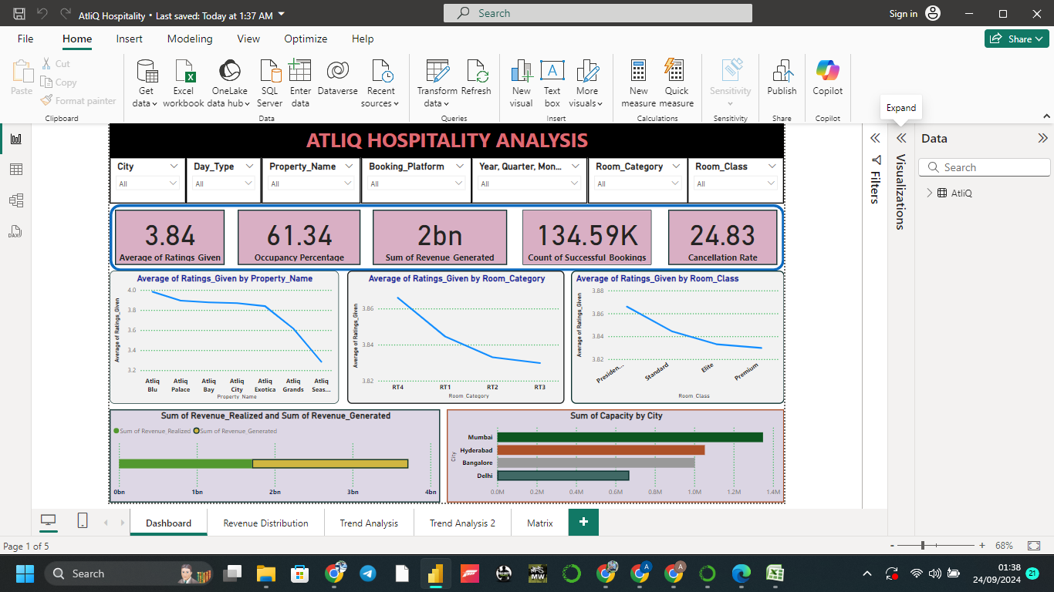
Dashboard

Slide 6
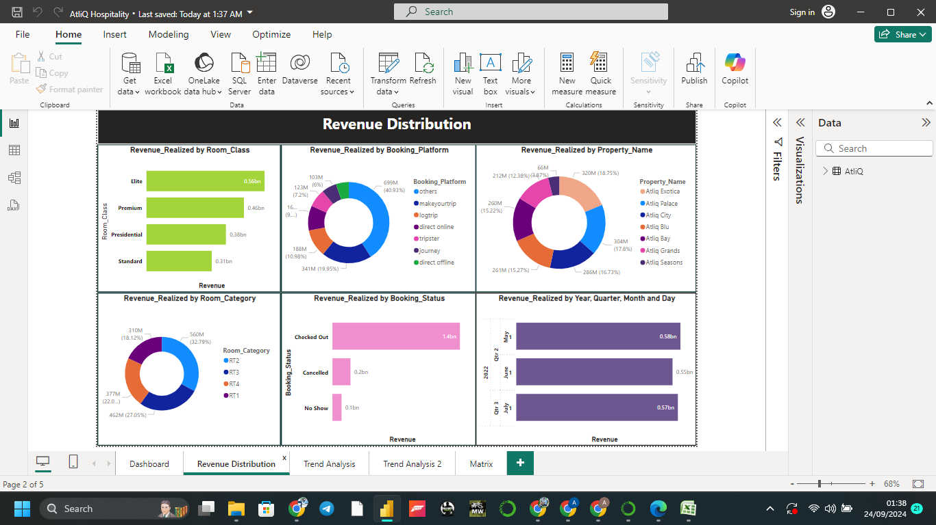
Revenue Distribution

Slide 7
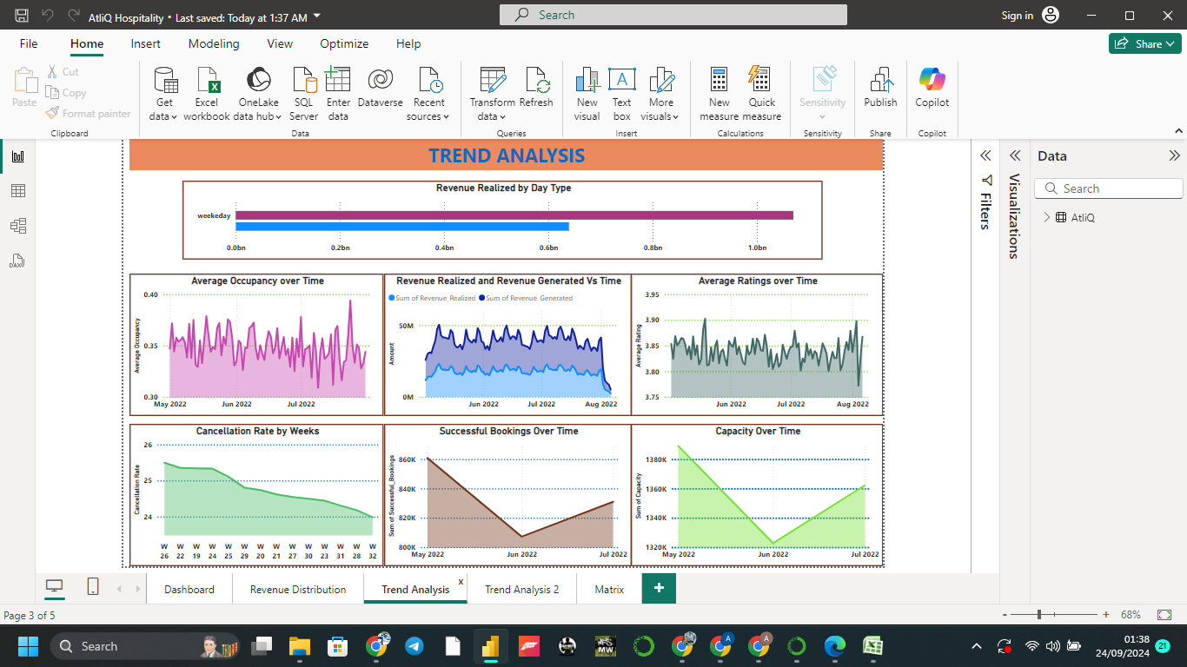
Trend Analysis

Slide 8
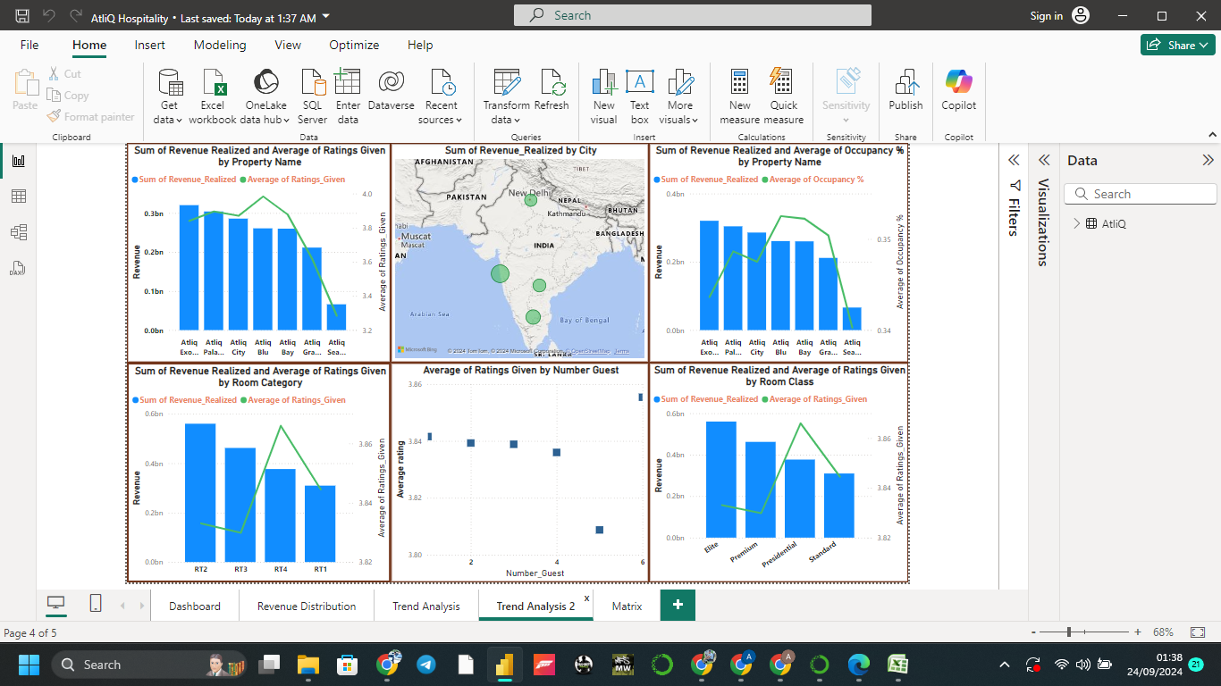

Slide 9
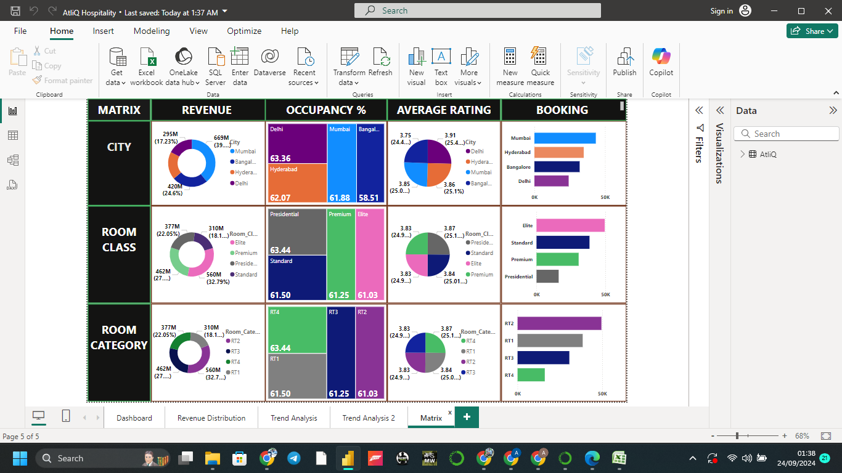
Matrix

Slide 10
Findings
Key Observations from the Matrix:
City-wise Performance:
Revenue:
  Mumbai is generating the highest revenue (669M), followed by Bangalore (420M) and Delhi (295M).
  Hyderabad is lagging behind, contributing only 295M in revenue.
Occupancy:
  Delhi has the highest occupancy at 63.36%, followed by Mumbai at 61.88%.
  Hyderabad has the lowest occupancy at 62.07%, but the gap is not large.
Average Rating:
  Mumbai has the highest average rating of 3.91.
  Hyderabad has the lowest at 3.75.
Bookings:
  Mumbai again dominates in bookings, followed by Hyderabad and Bangalore.
Room Class Performance:
Revenue:
  Presidential rooms are generating the most revenue (560M), followed by Standard rooms (462M).
  Elite rooms are contributing significantly less (377M), despite being a higher class.
Occupancy:
  Presidential rooms have the highest occupancy at 63.44%, while Elite rooms trail at 61.03%.
Average Rating:
  Presidential rooms lead in ratings with 3.87, while Elite rooms score the lowest with 3.83.
Bookings:
  Standard rooms have the highest bookings, while Elite rooms have the least.

Slide 11
Room Category Performance:
Revenue:
  RT2 rooms generate the highest revenue (560M), while RT4 rooms contribute the least (377M).
Occupancy:
  RT4 rooms lead in occupancy at 63.44%, and RT1 rooms are the lowest at 61.50%.
Average Rating:
  All room categories have similar ratings (ranging from 3.83 to 3.84).
Bookings:
  RT2 rooms have the highest bookings, while RT1 rooms have the lowest.
Revenue Realized and Ratings by Property:
Revenue: Atliq Exotica and Atliq City properties are generating the highest revenue, while Atliq Grande and Atliq Seasons are lagging in revenue generation.
Ratings: Properties like Atliq City and Atliq Blu have relatively high ratings, but properties like Atliq Grande and Atliq Seasons have significantly lower ratings.
Occupancy vs. Revenue by Property:
Atliq Exotica and Atliq City properties have strong revenue and occupancy percentages, indicating efficient operation.
Atliq Grands and Atliq Seasons properties, despite being lower in both revenue and occupancy, should be given special focus to improve performance.
  Action: Reassess the pricing, marketing, and service offerings of Atliq Grands and Atliq Seasons. Promotions or discounts to boost occupancy and guest satisfaction might help here.

Slide 12
Revenue and Ratings by Room Category:
RT2 generates the highest revenue, while RT1 generates the least.
  RT4 and RT3 have moderate revenue.
RT2 has the best ratings, indicating a strong guest satisfaction level, while RT1 is rated the lowest.
  Action: Since RT2 performs well, it may be a good idea to increase its availability. For RT1, consider improving services and experiences to boost guest satisfaction.
Revenue and Ratings by Room Class:
Presidential Rooms generate the highest revenue, followed by Standard Rooms.
Interestingly, Standard Rooms have higher occupancy rates than Premium or Elite rooms, even though they generate less revenue.
Elite Rooms have lower ratings, indicating guest dissatisfaction.
  Action: Focus on improving the guest experience in Elite rooms by offering better service or amenities. This could bring the ratings and revenue up to match the other room classes.
Guest Numbers vs. Ratings:
Guest numbers do not seem to correlate strongly with average ratings, suggesting that other factors (such as service quality or amenities) may have a greater impact on satisfaction.
  Action: Understanding specific reasons for lower ratings among certain room categories or properties will help refine service offerings, regardless of guest numbers.

Slide 13
Key Metrics Observed
Average Ratings Given: 3.84 (out of 5) - This is relatively low and shows there might be areas of customer dissatisfaction.
Occupancy Percentage: 61.34% - There is room for improvement, as a higher occupancy rate (closer to 80-90%) is ideal in the hospitality industry.
Revenue Generated: 2 billion - Indicates substantial revenue, but there could be opportunities to boost this.
Count of Successful Bookings: 134.59K - While a good count, the relatively high cancellation rate may negatively affect this figure.
Cancellation Rate: 24.83% - A cancellation rate of nearly 25% is high and needs attention.
Revenue Realized by Room Class: Elite class contributes the most revenue (0.56bn), followed by Premium, Presidential, and Standard.
Revenue by Booking Platform: Most revenue comes from “makeyourtrip” and “direct online” platforms, while “logtrip” and “tripster” contribute less.
Revenue by Property Name: “Atliq Exotica” generates the most revenue, followed by “Atliq Palace.” “Atliq Grands” is the least performing.
Revenue by Room Category: RT3 (32.79%) generates the most revenue, followed by RT1 and RT2.
Revenue by Booking Status: Most of the revenue is realized from checked-out bookings, with cancellations and no-shows contributing very little.
Revenue by Year, Quarter, Month, and Day: Q4 in 2022 appears to have slightly higher revenue compared to other quarters.

Slide 14
Areas Where Hospitality is lagging
Low Average Ratings:
Ratings by Property Name: Some properties like "Atliq Blu" have better ratings compared to "Atliq Exotica,“ which shows a steady decline in ratings.
Ratings by Room Category: Room categories like RT4, RT3, etc., have declining ratings.
Ratings by Room Class: Higher-class rooms (Elite, Premium) have received lower ratings compared to standard or Presidential rooms.
Action: Focus on improving the guest experience, particularly in properties and rooms with lower ratings. Analyzing customer feedback could identify areas where service is lagging (e.g., cleanliness, amenities, or customer service).
Occupancy & Capacity:
Some cities like Hyderabad show lower utilization of capacity compared to Mumbai and Bangalore.
Action: Target marketing campaigns in cities with lower occupancy to attract more customers. Offering promotions, loyalty programs, and packages for extended stays might help improve occupancy.
High Cancellation Rate (24.83%):
This is significantly high and should be addressed.
Action: Investigate the reasons behind cancellations by gathering feedback. Common causes could be inflexible booking policies, better pricing on competitor platforms, or dissatisfaction with the service. Offering more flexible booking and cancellation policies, or providing incentives for non-cancellations, may help.
Room Category and Class Optimization:
Higher-end rooms (Premium, Elite) are receiving lower average ratings, which could imply dissatisfaction among higher-paying customers.
Action: Ensure that premium room categories justify their pricing by improving the quality of amenities, customer service, and overall experience. Conduct a review to understand the specific issues with higher-end rooms.

Slide 15
Recommendations to Improve Revenue Reduce Cancellations, and Boost Weekday Occupancy
Improve Guest Experience:
  Focus on improving the areas that contribute to low customer satisfaction, especially in the room categories with declining ratings. Improved services in food, housekeeping, and quicker response to customer requests will help increase the overall rating.
Targeted Marketing for Low-Occupancy Locations:
  Focus marketing efforts in cities like Hyderabad where the occupancy rate is lower. Offering location-specific discounts or event-driven promotions can attract more guests.
Weekday Specials:
  Create attractive weekday offers, such as corporate packages, satiations, or discounted room rates during off-peak periods to drive up weekday bookings.
Flexible Cancellation Policies:
  Introduce flexible booking and cancellation policies, such as no-fee cancellations up to 48 hours before the check-in date. You can also provide discounts for guests who do not cancel or offer credits for future stays.
Enhance Premium Services:
  Improve services for the high-end room categories to meet customer expectations. Ensure premium rooms offer a distinctive experience that justifies the cost. Regular surveys or feedback from premium guests can provide actionable insights for improvement.
Incentivize Repeat Bookings:
  Implement loyalty programs or offer incentives for guests who make repeat bookings or recommend others. This will help both with customer retention and word-of-mouth growth.

Slide 16
Focus on Improving Hyderabad's Performance:
  Revenue and Occupancy: Hyderabad is lagging in revenue generation compared to other cities like Mumbai and Bangalore. Efforts should be made to boost marketing in this region, targeting local events, business conferences, and tourism.
  Ratings: Hyderabad has the lowest ratings. It’s important to analyze feedback and reviews from this city to improve guest satisfaction. Enhancing service quality and offering additional amenities could help improve customer experiences.
Improve the Performance of Elite Rooms:
  Low Revenue and Bookings: Despite being a high-class room, Elite rooms are contributing significantly less revenue and bookings compared to standard and Presidential rooms. This could be due to the pricing not matching the perceived value.
  Low Occupancy and Ratings: The occupancy and ratings of Elite rooms are lower, suggesting customer dissatisfaction. Focus on improving the guest experience in Elite rooms by enhancing luxury amenities, offering better customer service, and providing personalized experiences.
Maximize the Potential of RT4 Room Category:
  Low Revenue and Bookings: RT4 rooms are generating the least revenue and bookings despite having the highest occupancy rate.
Boost Mid-Week Occupancy:
  Since occupancy rates are hovering around 60-63%, there is potential to increase weekday occupancy. Implement special weekday promotions, such as business traveller discounts, long-stay packages, or remote working-friendly offers. Creating targeted campaigns for weekday stays in cities like Hyderabad and Bangalore could help balance weekend vs. weekday occupancy.
Reduce Cancellation Rates:
  Cancellations affect both occupancy and revenue. Flexible cancellation policies combined with incentives (such as credits or discounts for future bookings) can help reduce cancellations. Offering alternatives like rescheduling or providing upgrades for non-cancelled bookings can help reduce the current cancellation rate.

Slide 17
Comprehensive Recommendations by performance
Improve Atliq Grande and Atliq Seasons Performance:
Revenue and Occupancy: These properties are underperforming in both revenue and occupancy. Special attention is needed to revamp marketing strategies, offer local promotions, and analyze guest feedback to identify areas for improvement.
Ratings: Addressing guest concerns and enhancing the overall experience will be crucial for Atliq Grande and Seasons. Consider luxury add-ons or a personalized guest experience program to make them more attractive.
Maximize RT2 Category Potential:
Strong Revenue and Ratings: With the highest revenue and ratings, RT2 should be promoted heavily. Increasing the number of available rooms in this category, particularly for peak seasons, will help capitalize on guest demand.
Improve RT1: Since RT1 has the lowest ratings and revenue, improving its quality and offerings (better decor, facilities, or service) could help boost its performance.
Elite Rooms Require Attention:
Low Revenue and Ratings: Elite rooms are lagging behind other room classes. Consider offering discounted upgrades to Elite rooms to attract guests from other categories, and work on enhancing guest experience for better ratings.
Action: Reassess the price-value balance of Elite rooms and identify why guest satisfaction is low (e.g., service, comfort, amenities).
Target Promotions for Weekday Stays:
Given that properties like Atliq City are strong revenue drivers, they could offer business travel packages or remote working incentives to boost weekday occupancy.
Action: Implement weekday promotions, targeting business travellers and families looking for mid-week getaways. This could reduce cancellations and increase occupancy during typically slower periods.

Slide 18
Rebalance Room Category Offerings:
RT2 and RT3 should be prioritized in marketing and booking strategies due to their consistent performance. RT1 rooms should receive special attention to address guest concerns and improve their attractiveness.
Up selling Opportunities: Encourage guests to upgrade to higher-performing room categories during check-in or pre-arrival, especially from RT1 to RT2 or RT3.
Enhance Loyalty Programs:
Properties like Atliq Exotica and Atliq City, which have consistently high revenue, could implement loyalty programs to encourage repeat bookings. This would help maintain their strong performance.
Action: Develop tiered loyalty programs offering exclusive deals, free upgrades, or complementary services for returning customers.
Focus on Data-Driven Service Enhancements:
Use the feedback and ratings trends to make data-driven decisions for service improvements, especially in properties or room categories that are underperforming in guest satisfaction.
Action: Implement periodic surveys and collect reviews to gain deeper insights into specific areas that need improvement.

Slide 19
Code for file merging
import os
import pandas as pd
import numpy as np
os.chdir("E:\\UM_Project\\Hospitality")
Dates=pd.read_csv("dim_date.csv")
hotel=pd.read_csv("dim_hotels.csv")
room=pd.read_csv("dim_rooms.csv")
aggregated=pd.read_csv("fact_aggregated_bookings.csv")
DATA=pd.read_csv("fact_bookings.csv")
JOIN_Dates_Aggregated = pd.merge(Dates, aggregated, left_on='date', right_on='check_in_date', how='outer')
JOIN_Dates_Aggregated.head()
JOIN_Dates_Aggregated_room = pd.merge(room, JOIN_Dates_Aggregated, left_on='room_id', right_on='room_category', how='outer')
JOIN_Dates_Aggregated_room.head()
JOIN_Dates_Aggregated_room_hotel = pd.merge(hotel, JOIN_Dates_Aggregated_room, left_on='property_id', right_on='property_id', how='outer')
JOIN_Dates_Aggregated_room_hotel.head()
are_equal = JOIN_Dates_Aggregated_room_hotel['date'].equals(JOIN_Dates_Aggregated_room_hotel['check_in_date'])
print("Columns are exactly equal:", are_equal)
table_1=JOIN_Dates_Aggregated_room_hotel.drop(['room_id','date'],axis=1)
table_1.head()
table_1['concat'] = (
table_1['property_id'].astype(str) + '_' +
table_1['check_in_date'].astype(str) + '_' +
table_1['room_category'].astype(str)
)
DATA['check_in_date'] = pd.to_datetime(DATA['check_in_date'])
DATA['formatted_date'] = DATA['check_in_date'].dt.strftime('%d-%b-%y')
DATA.drop(['check_in_date'],axis=1)
DATA['concat'] = (
DATA['property_id'].astype(str) + '_' +
DATA['formatted_date'].astype(str) + '_' +
DATA['room_category'].astype(str)
)
Merged = pd.merge(table_1, DATA, on='concat', how='outer')
Merged.head()
Clean_data=Merged.drop(['property_id_x','room_category_x','check_in_date_x','concat','formatted_date'],axis=1)
Clean_data.head()
median_rating = Clean_data['ratings_given'].median()
Clean_data['ratings_given'].fillna(median_rating, inplace=True)
Clean_data.to_csv("E:\\UM_Project\\Hospitality\\AtliQ.csv", index=False)

